Slide 1
Explore integration of Tudor’s ML method into IMPC
Carrying on from the presentation Tudor presented
Reminder of method

Slide 2
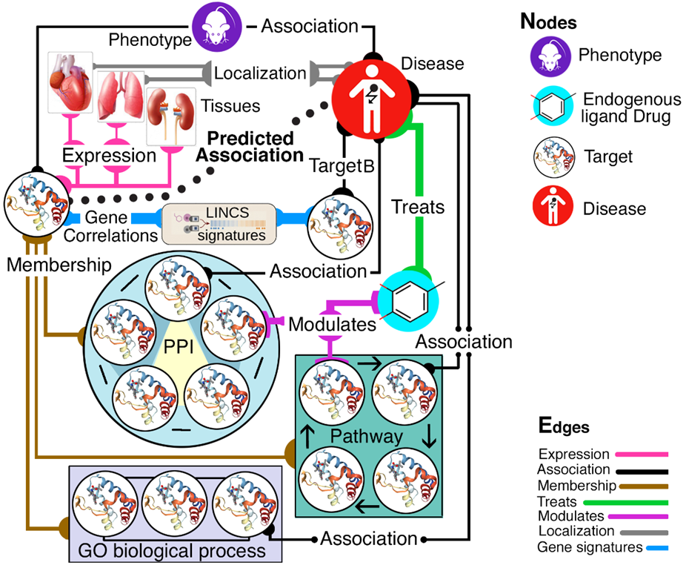

Protein knowledge graphs
IDG KMC2 seeks knowledge gaps across the five branches of the “knowledge tree”:
Genotype; Phenotype; Interactions & Pathways; Structure & Function; and Expression, respectively.
We can use biological systems network modeling to infer novel relationships based on available evidence, and infer new “function” and “role in disease” data based on other layers of evidence
Primary focus on Tdark & Tbio
O. Ursu, T Oprea et al., IDG2 KMC
2/01/18 revision

Slide 3
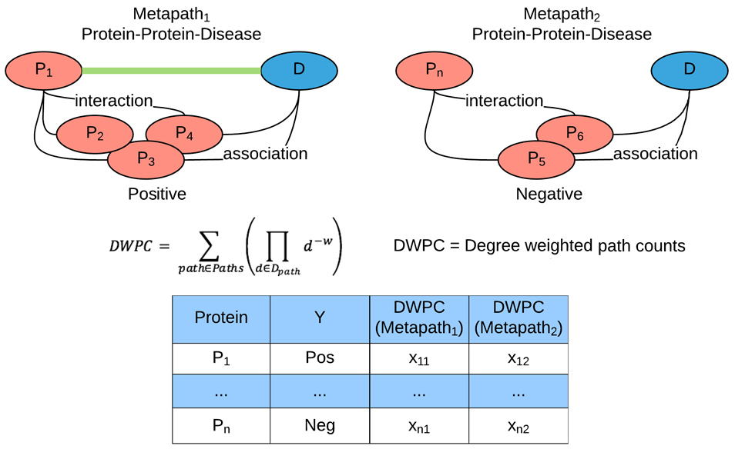
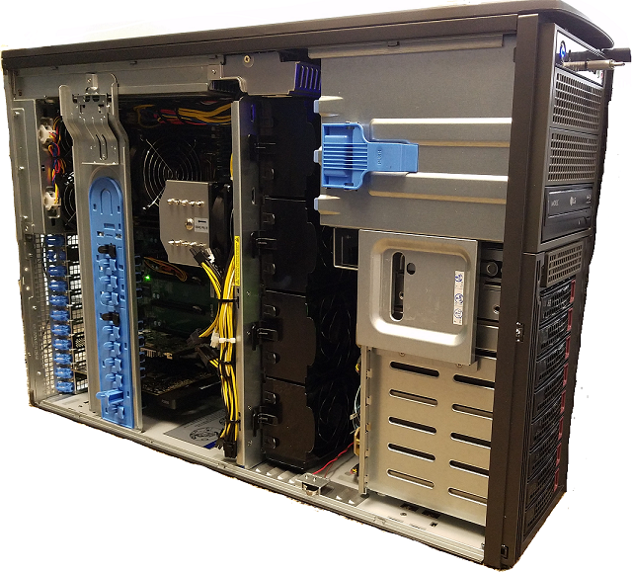
Machine learning as precursor to AI
one protein-disease association at the time
Genes associated with a disease/phenotype are positive examples, whereas genes lacking the same association are negative examples. The Metapath approach transforms assertions/evidence chains into classification problems that can be solved using suitably designed machine learning algorithms.
O. Ursu, T Oprea et al., IDG2 KMC
2/01/18 revision

Slide 4
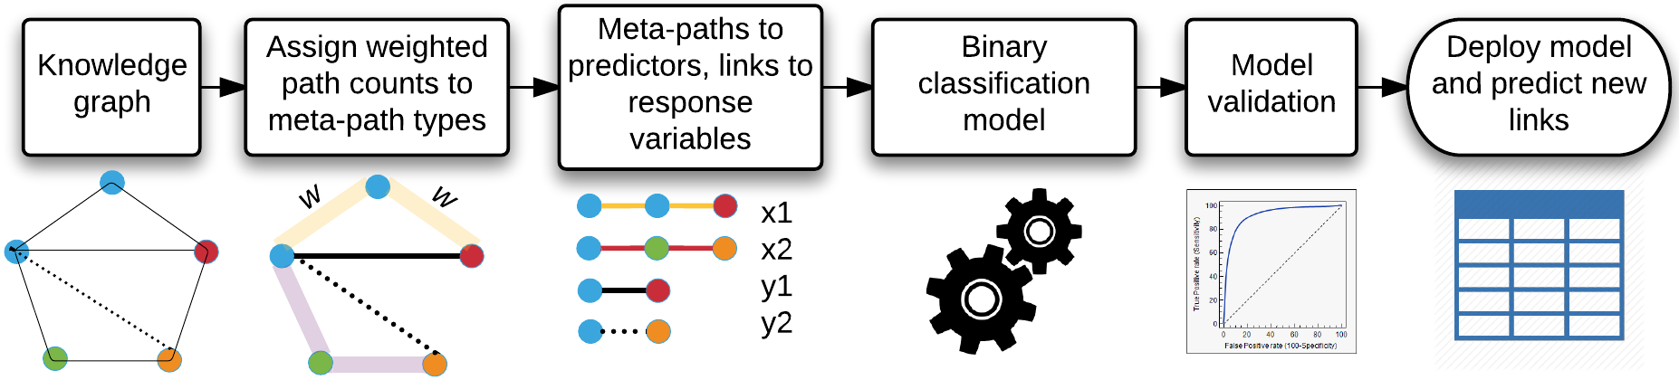
METAPATH ALGORITHM WORKFLOW
A meta-path encodes type-specific network topology between the source node (e.g., Protein target) and the destination node (e.g., Disease or Function)
Target –– (member of) → PPI Network ← (member of) –– Protein –– (associated with) → Disease
Target –– (expressed in) → Tissue ← (localized in) –– Disease
O. Ursu, T Oprea et al., IDG2 KMC
2/01/18 revision

Slide 5
Tudor’s ML method
Tudor provided access to the input and output data from the Machine Learning pipeline
As a group, we discussed the method and pipeline for detecting candidate genes for phenotypes and diseases
Identified useful cases to explore

Slide 6
Tudor’s ML method: conclusions / lessons learned
It’s complicated!
Lots of input data (manual configuration)
Lots of output data
(20,000+ rows, 20,000+ columns) 2GB output in binary format for each MP term analyzed
Next steps are to attempt to re-implement the method and EBI and Harwell
* - helpful definitions from hackathon.guide

Slide 7
automated data aggregation for ML
Data source | Data type | Data points
CCLE | Gene expression | 19,006,134
GTEx | Gene expression | 2,612,227
Protein Atlas | Gene & Protein expression | 949,199
Reactome | Biological pathways | 303,681
KEGG | Biological pathways | 27,683
StringDB | Protein-Protein interactions | 5,080,023
Gene ontology | Biological pathways & Gene function | 434,317
InterPro | Protein structure and function | 467,163
ClinVar | Human Gene - Disease/Phenotype associations | 881,357
GWAS | Gene - Disease/Phenotype associations | 54,360
OMIM | Human Gene - Disease/Phenotype associations | 25,557
UniProt Disease | Human Gene - Disease/Phenotype associations | 5,365
JensenLab DISEASE | Gene - Disease associations from text mining | 44,829
NCBI Homology | Homology mapping of human/mouse/rat genes | 70,922
IMPC | Mouse Gene - Phenotype associations | 2,153,999
RGD | Rat Gene - Phenotype associations | 117,606
LINCS | Drug induced gene signatures | 230,111,315
We developed automated methods for data collection (TCRD), visualization (Pharos) and data aggregation.
These aggregated datasets were used to build machine learning models for 20+ disease and 73 mouse phenotype.
Each knowledge graph contains ~22,000 metapaths and 284 million path instances.
O. Ursu et al., manuscript in preparation
10/07/18 revision

Slide 8
Tudor’s ML method: next steps
Get access to existing input data and results (complete)
Download and explore results (ongoing)
Validation of results
* Receive code from Tudor’s group (in progress)
Next steps are to attempt to re-implement the method and EBI and Harwell and HMGU
* - helpful definitions from hackathon.guide

Slide 9
Tudor’s ML method: next steps
Potential improvements that we can contribute to the method
1) GPU instead of CPU (or general optimization)
2) Parallelization of algorithm
3) Understating and rationalizing of the method / results
4) and more…
* - helpful definitions from hackathon.guide

